Slide 1
Contents of the Unit
Connecting devices
Backbone networks
Virtual LANs
Virtual Circuit Networks:
- Frame Relay
- ATM
- ATM LANs

Slide 2
Introduction – Connecting Devices
LANs do not normally operate in isolation.
They are connected one another or to the Internet.
To connect LANs, or segments of LANs, connecting devices are used.
Connecting devices can operate in different layers of Internet model.

Slide 3
Five Categories of Connecting Devices
Connecting devices can be categorized into five based on the layer in which they operate in a network.
- Below the physical layer: passive hub
- At the physical layer: repeater or active hub
- At the physical and data link layers: bridge or two-layer switch
- At the physical, data link, network layers: router or three-layer switch
- At all five layers: gateway

Slide 4

Five categories of connecting devices

Slide 5
Passive Hubs
Its location is below the physical layer in the Internet model.
It is just a connector.
It connects the wires coming from different branches.
This type of hub is part of the media.

Slide 6
Repeater
It operates only in the physical layer.
It receives a signal, and before it becomes too weak or corrupted, regenerates the original bit pattern, then sends the refreshed signal.
It can extend the physical length of a LAN.
It does not actually connect two LANs, it connects two connects two segments of the same LAN.
It can overcome the 10Base5 Ethernet length restriction.
It forwards every frame, it has no filtering capability.

Slide 7

It acts as a two-port node. When it receives a frame from any of the ports, it regenerates and forwards it to the other port.
A repeater connecting two segments of a LAN

Slide 8

A repeater is a regenerator, not an amplifier.
The location of a repeater on link is vital.
Function of a Repeater

Slide 9

Active Hubs
It is actually a multiport repeater.
It is normally used to create connections between stations in a star topology.
Hubs can also be used to create multiple levels of hierarchy; removing the length limitation of 10Base-T (100m).
A hierarchy of hubs

Slide 10
Bridges
It operates in both physical and data link layers.
As a physical layer device, it regenerates the signal it receives, and, as a data link layer device, the it can check the MAC addresses.
It has filtering capability: it can check the destination address of a frame and decide if the frame should be forwarded or dropped.
If the frame is to be forwarded, the decision must specify the port. For that it has a table used in filtering decisions. Table maps addresses to the ports.
A bridge does not change the physical (MAC) addresses in a frame.

Slide 11
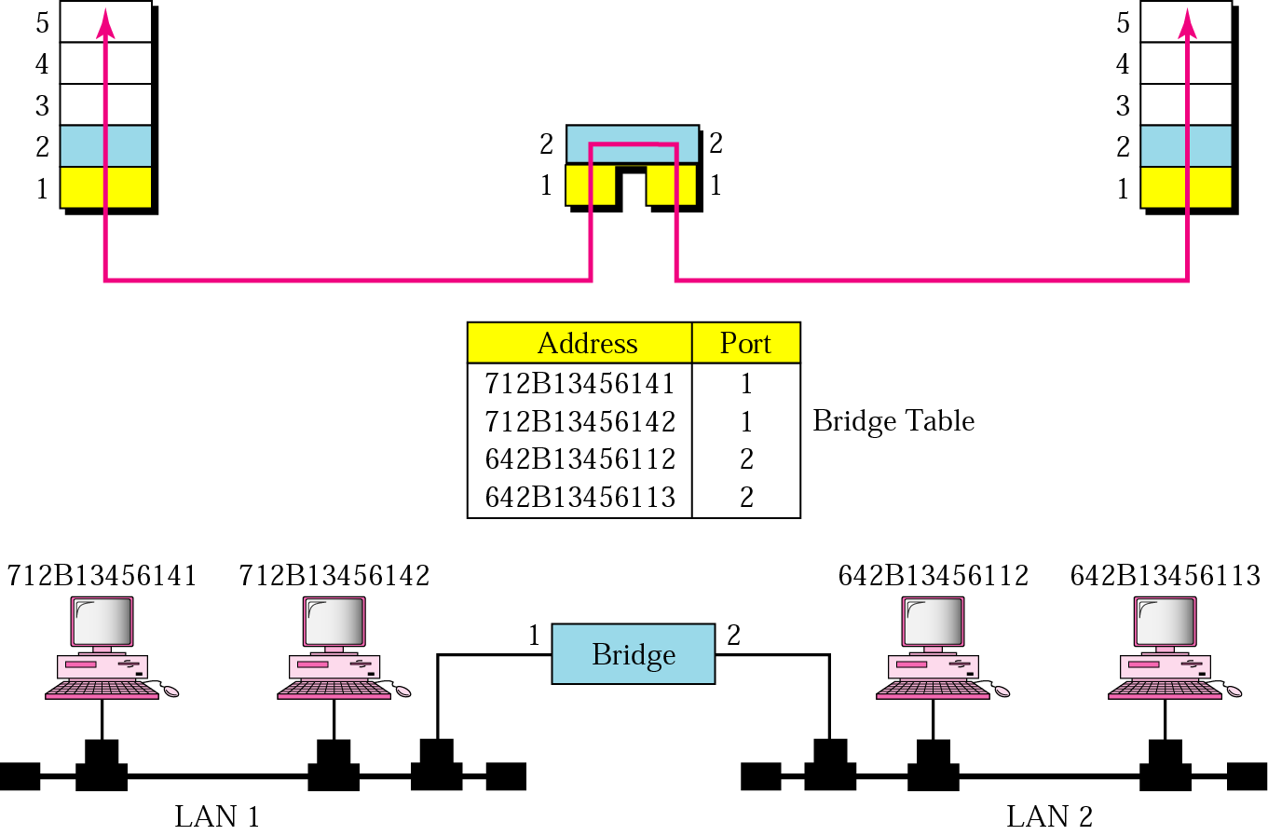
A bridge connecting two LANs

Slide 12
Bridges Connecting Different LANs
There are many issues to be considered while connecting LANs using different protocols at the data link layer using Bridges.
(for eg. an Ethernet LAN to a wireless LAN)
Frame format
Maximum data size
Data rate
Bit order
Security
Multimedia support

Slide 13
Two-Layer Switches
It performs at the physical and data link layers.
It is basically a bridge, a bridge with many ports and a design that allows better (faster) performance.
It can be more sophisticated: have a buffer to hold the frames for processing, and have a switching factor that forwards the frames faster.

Slide 14
Routers
It is a three-layer device that routes packets based on their logical addresses.
It normally connects LANs and WANs in the Internet and has a routing table that is used for making decisions about the route.
Routing tables are normally dynamic and are updated using routing protocols.

Slide 15

Routers connecting independent LANs and WANs

Slide 16
Three-Layer Switches
It is a router, but a faster and more sophisticated.
Switching fabric in a three-layer switch allows faster table lookup and forwarding.
(in this book, the terms router and three-layer switch are used interchangeably)

Slide 17
Gateway
Though some textbooks use the terms gateway and router interchangeably, most of the literature distinguishes between the two.
It is normally a computer that operates in all five layers of the Internet or seven layers of OSI model.
It takes an application message, reads it, and interprets it; means that it can be used as a connecting device between two internetworks that use different models.
It can provide security (can filter unwanted application-layer messages).

Slide 18
Backbone Networks
Connecting devices can be used to create backbone networks.
A backbone network allows several LANs to be connected.
In a backbone network, no station is directly connected to the backbone; the stations are part of a LAN, and the backbone connects the LANs.
The backbone is itself a LAN that uses a LAN protocol such as Ethernet; each connection to the backbone is itself another LAN.
Many different architectures can be used for a backbone, the two most common: the bus and the star.

Slide 19
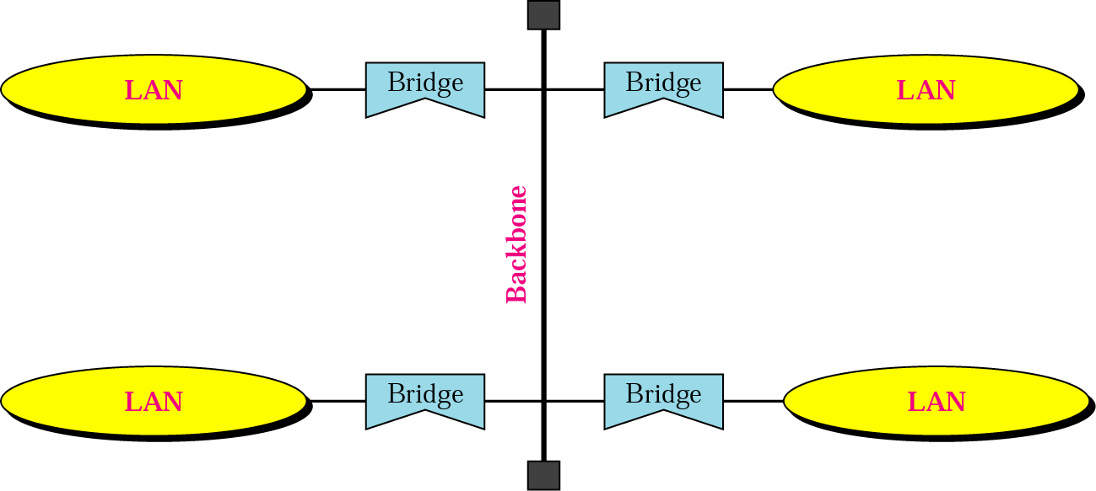
Bus Backbone
In a bus backbone, the topology of the backbone is a bus.
The backbone itself can use one of the protocols that support a bus topology such as 10Base5 or 10Base2.
Normally used as a distribution backbone to connect different buildings in an organization.
Bus backbone

Slide 20
If a station in a LAN needs to send a frame to another station in the same LAN, the corresponding bridge blocks the frame, the frame never reaches the backbone.
However, if a station needs to send a frame to a station in another LAN, the bridge passes the frame to the backbone, which is received by the appropriate bridge and is delivered to the destination LAN.
Each bridge connected to the backbone has a table that shows the stations on the LAN side of the bridge.
The blocking or delivery of a frame is based on the contents of this table.

Slide 21
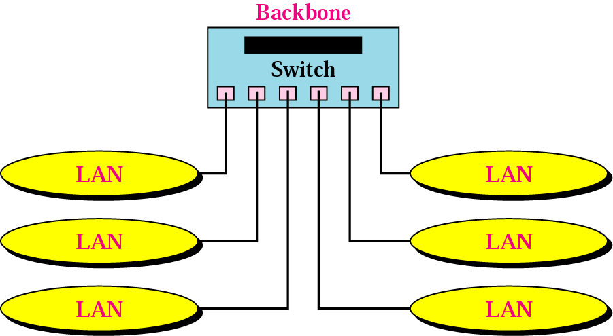
Star Backbone
Sometimes called a Collapsed or switched backbone.
The topology of the backbone is a star.
In this configuration, the backbone is just one switch that connects the LANs.
Star backbones are mostly
used as a distribution
backbone inside a building.
Star backbone

Slide 22
Connecting Remote LANs
Another application for a backbone network is to connect remote LANs.
This type of backbone network is useful when a company has several offices with LANs and needs to connect them.
The connection can be done through bridges, sometimes called Remote bridges.
A point-to-point link acts as a LAN in a remote backbone connected by remote bridges.
The bridges act as connecting devices connecting LANs and point-to-point networks, such as leased telephone lines and ADSL lines.
The point-to-point link can use a protocol such as PPP.

Slide 23
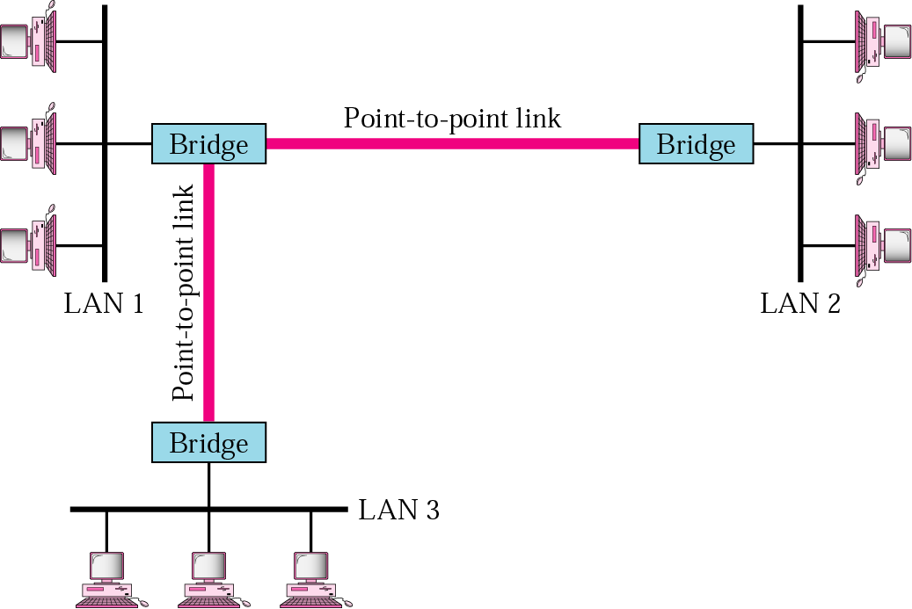
Connecting remote LANs with bridges

Slide 24
Virtual LANs (VLANs)
A station is considered part of a LAN if it physically belongs to that LAN. The criterion of membership is geographic.
VLAN is a local area network configured by software, not by physical wiring.
In a switched LAN, changes in the work group mean physical changes in the network configuration.
For e.g., left side fig. shows a switched LAN in an engineering firm in which 10 stations are grouped into 3 LANs that are connected by a switch.
The first 4 engineers work together as the 1st group, the next 3 engineers work together as the 2nd group, and the last 3 engineers work together as the 3rd group.

Slide 25
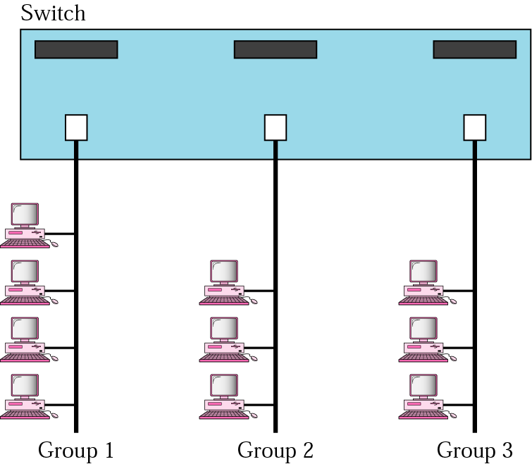
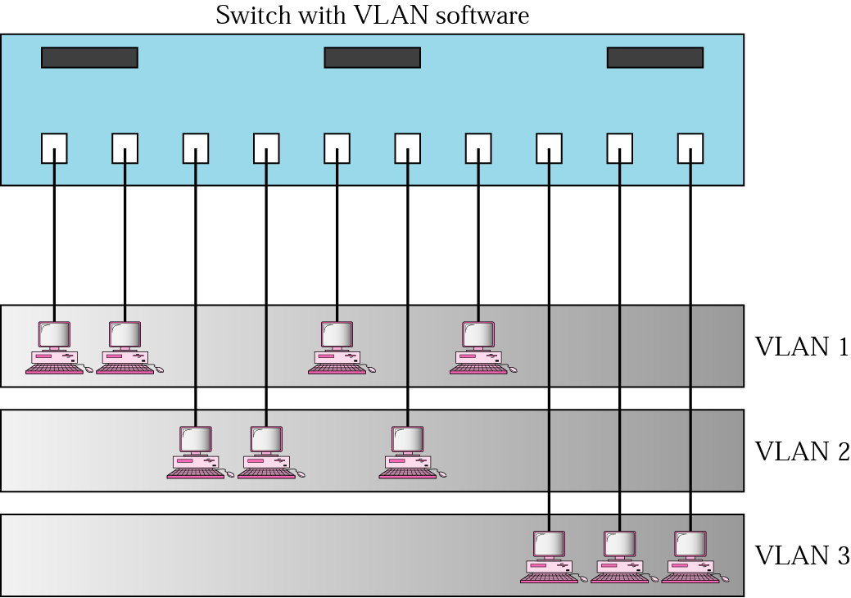
A Switch connecting three LANs
A Switch using VLAN software

Slide 26
The problem here is, if the administrators needed to move 2 engineers from the 1st group to 3rd group, to speed up the project being done by the 3rd group, the LAN configuration would need to be changed, the network technician must rewire.
This problem is repeated if, in another week, the two engineers move back to their previous group.
This problem can easily be solved by using VLANs.
Moving engineers from one group to another through software is easier than changing the configuration of the physical network (Right side fig. shows the same switched LAN divided into VLANs).

Slide 27
The whole idea of VLAN technology is to divide a LAN into logical, instead of physical, segments.
A LAN can be divided into several logical LANs called VLANs.
Each VLAN is a work group in the organization. If a person moves from one group to another, there is no need to change the physical configuration.
The group membership in VLANs is defined by software, not hardware.
Any station can be logically moved to another VLAN.
All members belonging to a VLAN can receive broadcast messages sent to particular VLAN.

Slide 28
VLAN technology also allows the grouping of stations connected to different switches in a VLAN.
Fig. shows backbone LAN with 2 switches and 3 VLANs.
Stations from switches A and B belong to each VLAN.
This is a good configuration for a company with two separate buildings.
Each building can have its own switched LAN connected by a backbone. People in the first building and people in the second building can be in the same work group even though they are connected to different physical LANs.
VLANs group stations belonging to one or more physical LANs into broadcast domains. The stations in a VLAN communicate with one another as though they belonged to a physical segment.

Slide 29
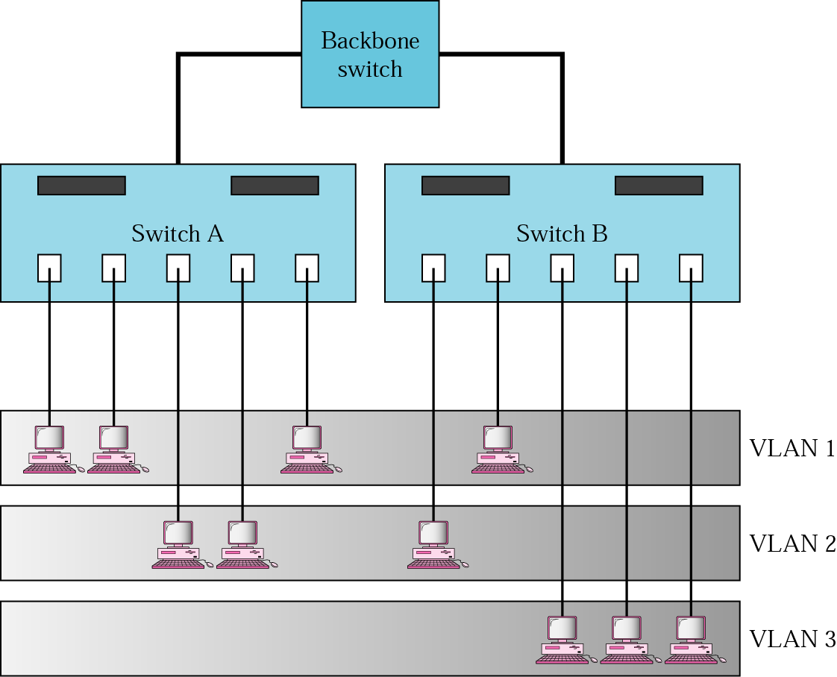
Two switches in a backbone using VLAN software

Slide 30
Membership
  Membership is characterized by port numbers, MAC addresses, IP addresses, Multicast IP addresses, or a combination of the above.
Configuration
  VLAN can be configured in one of three ways: manual, automatic, and semiautomatic.
  Manual: the network administrator uses the VLAN software to manually assign the stations into different VLANs at setup. Later migration from one VLAN to another is also done manually.
  Automatic: the stations are automatically connected or disconnected from a VLAN using criteria defined by the administrator.

Slide 31
  Semiautomatic: usually, initializing is done manually, with migrations done automatically.
Communication between switches
  in a multi-switched backbone, each switch must know not only which station belongs to which VLAN, but also the membership of stations connected to other switches.
  Three methods are devised: table maintenance, frame tagging, and time division multiplexing (TDM)
  Table maintenance: when a station sends a broadcast frame to its group members, the switch creates an entry in a table and records station membership. The switches send their tables to one another periodically for updating.

Slide 32
  Frame tagging: when a frame is traveling between switches, an extra header is added to the MAC frame to define the destination VLAN. The frame tag is used by the receiving switches to determine the VLANs to be receiving the broadcast message.
  TDM: the connection (trunk) between switches is divided into timeshared channels. The receiving switch determines the destination VLAN by checking the channel from which the frame arrived.
IEEE standard
IEEE 802.1Q defines the format for frame tagging, defines the format to be used in multi-switched backbones and enables the use of multivendor equipment in VLANs. It has opened the way for further standardization in other issues related to VLANs.

Slide 33
Advantages of VLAN
  Cost and time reduction: can reduce the migration time and cost of stations going from one group to another.
  Creating virtual workgroups: VLANs can be used to create virtual work groups.
  Security: VLANs can provide an extra measure of security. People belonging to the same group can send broadcast messages with the guaranteed assurance that users in other groups will not receive these messages.

